Slide 1
California Coastal Transportation Aerial Support for Community Resiliency (CC-TASCR) SMART Grant Proposal
MBDART.org
Notes:
Background:
Bachelor of Science – HSU
Master of Landscape Architecture & Environmental Planning, UCB
Past Executive Officer – Fort Ord Reuse Authority
Overseeing redevelopment of 45-sq mile areas between Monterey and Salinas
Award winning, educationally centered, base reuse project underway from 1994-2020 (legislated agency closure)
Joined Regional government services as Senior Advisor leading Economic development service line in 2020
Continued ongoing work in Monterey region including leading Monterey Bay DART as 501 c 3
Monterey Bay DART formed out of FORA Economic Development program
Today I’ll show some slides about the background and current directions of DART – both to illustrate the specific initiative, and also as an example of applying general ED principles to a specific location
My understanding is that each of you are engaged in supporting local/regional economic development within the priority communities portfolio. Such that my intention would be to describe the approach we took with the DART effort in Monterey, and illustrate some ED fundamentals that might be useful for your programs.
In general, I can say that our ED program at FORA began with the following foundations:
Build on regional strengths
Engage regional partners & stakeholders
Develop & maintain information resources
Pursue new business opportunities
Measure & report progress
It was the continued, steady pick and shovel efforts, and productive partnerships developed through doing that work, that has lead to the current moment.
So I hope you find this presentation stimulating and useful. Feel free to interject with questions along the way.

Slide 2
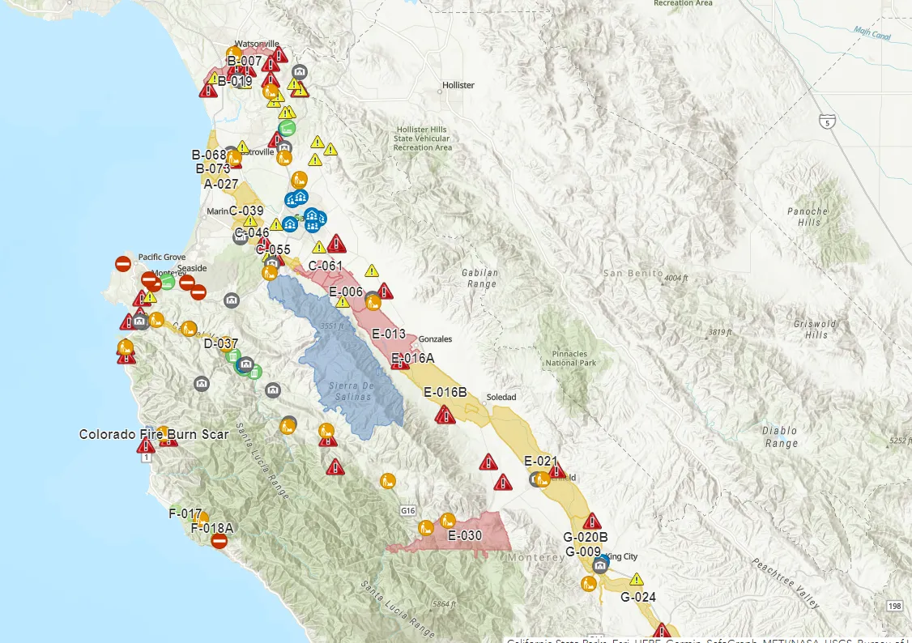
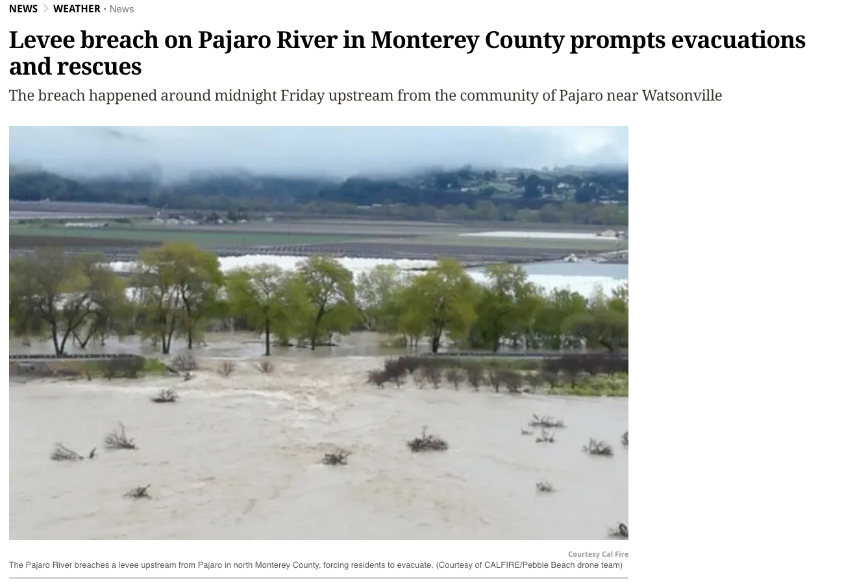
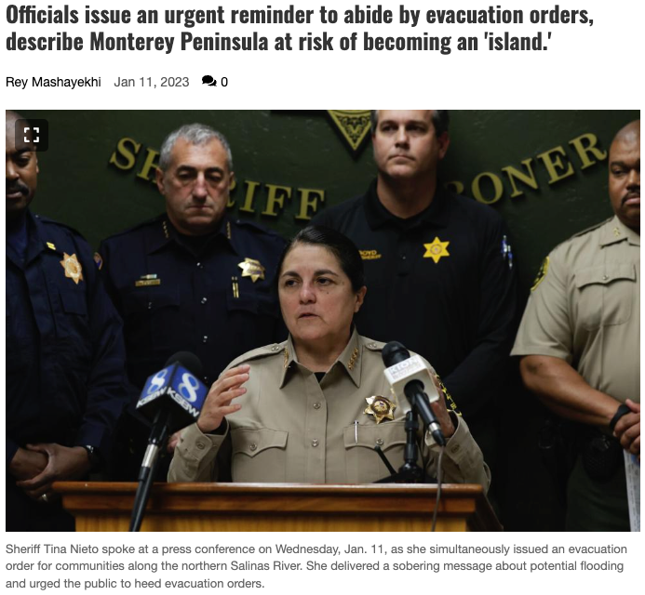
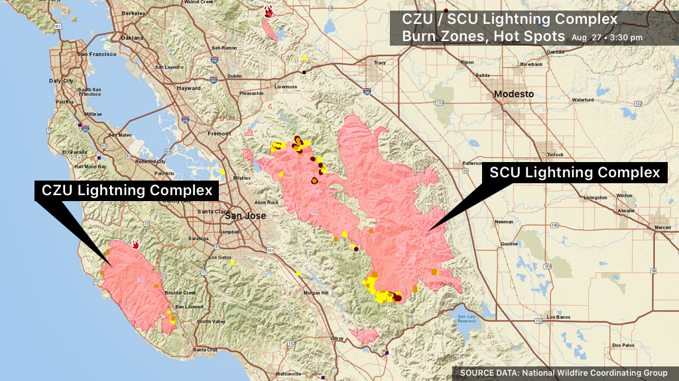
Why does this matter for the Central Coast?
Notes:
“Pineapple Express” - March 2023 hundreds impacted, County and private road closures and impacts

Slide 3
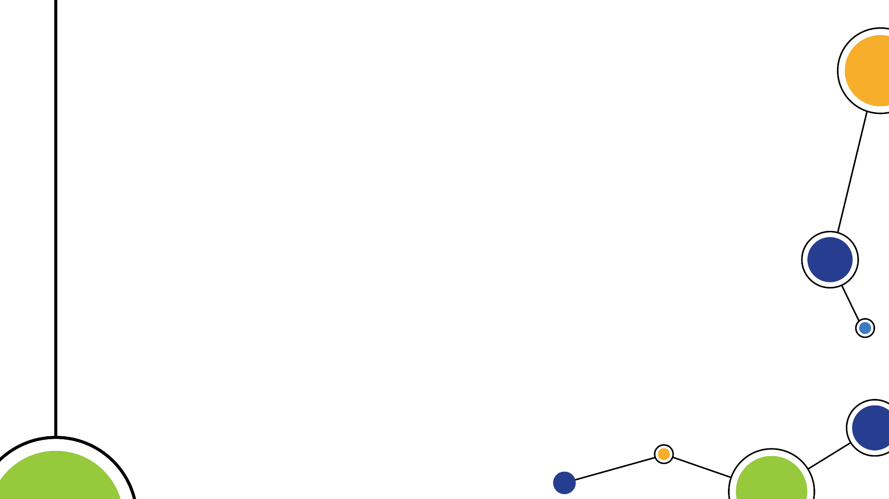
Regional Problems to Solve
Challenge | Enabling Use Case
Disaster Preparedness and Resiliency Wildland Fire Seismic Catastrophe Atmospheric River/Flooding/Erosion | Transportation Network Damage Assessment Infrared Data Collection over Fire Emergency Supply Delivery Imagery Data Collection
Rural Access to Timely Emergency Medical Response | Emergency Medical Delivery Emergency Response
Agricultural Production and Security | Multispectral Data Collection Surveys Spraying application
Transportation Infrastructure | Critical Infrastructure Data Collection Regional Damage Assessments
Right of Way Vegetation Management | Data Collection Surveys
Environmental and Ecological Research | Multisensor Data Collection
Notes:
Why specifically should TAMC and the Region at large care about enabling these technologies and leading adoption? - https://www.techbriefs.com/component/content/article/50241-amateur-drone-videos-could-aid-natural-disaster-damage-assessment
Engineers at the U.S. Army Corps of Engineers Research and Development Center are testing out Light Detection and Ranging systems attached to Unmanned Aerial Systems to create digital copies of levees for inspection. https://www.youtube.com/watch?v=YN3ZBcE2bMo

Slide 4
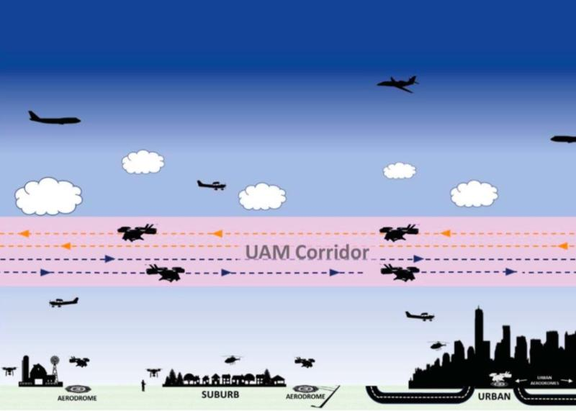
Minimum Viable Infrastructure (MVI)
Sensors and Navigation
Radars
Optical Sensors
RF Triangulation
Remote ID Sensors
Weather
Data Exchange Infrastructure
Human Resource(s)
Project Management
Site/Facilities Management
Community Engagement
Policy Implications

Slide 5
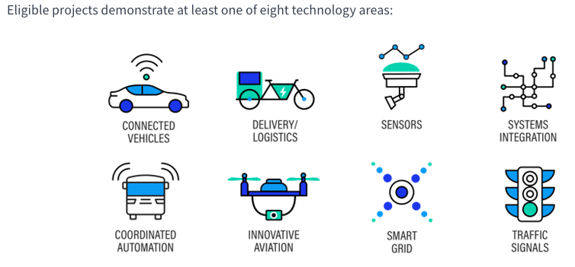
Project Alignment to SMART Grant
Eligible projects demonstrate at least one of eight technology areas:
Notes:
SMART technology areas of focus are explicit about the technologies we are hoping to demonstrate through proof of concept/pilot in Stage 1.
“Resiliency: Increase the reliability and resiliency of the transportation system, including cybersecurity and resiliency and adaptation to climate change effects.”

Slide 6
Project Partners

Slide 7
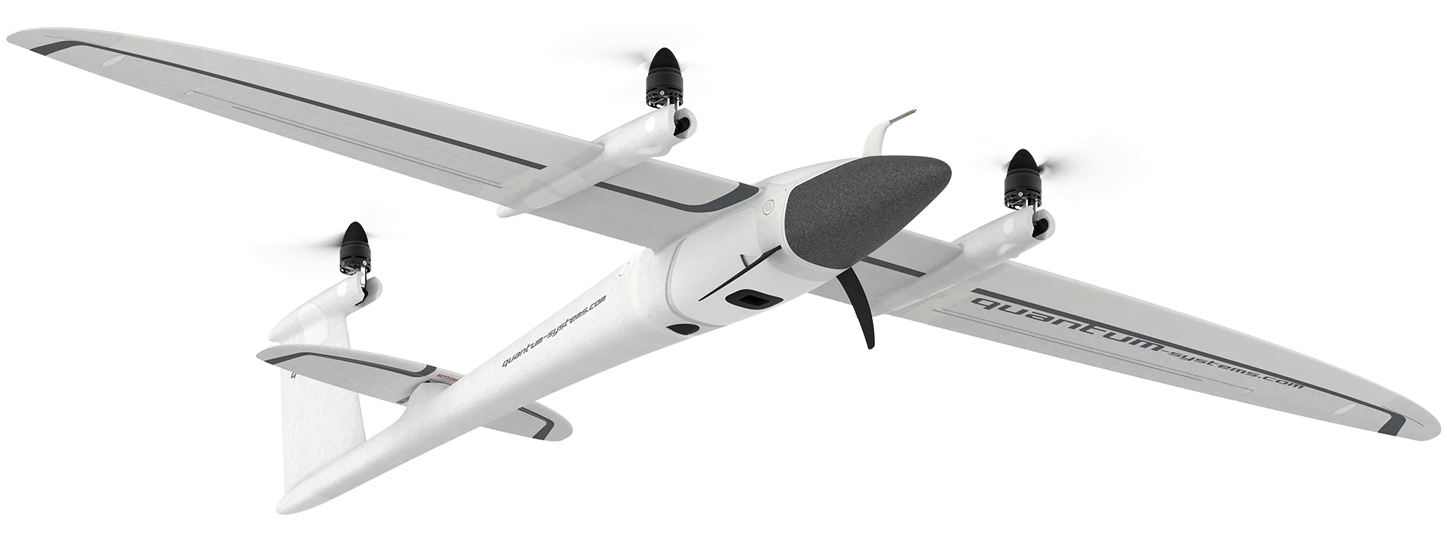
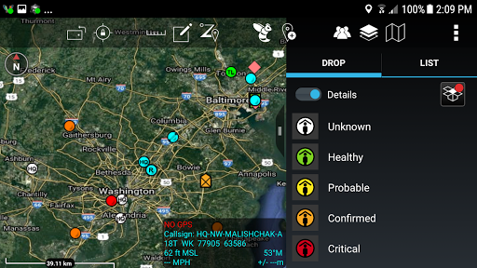
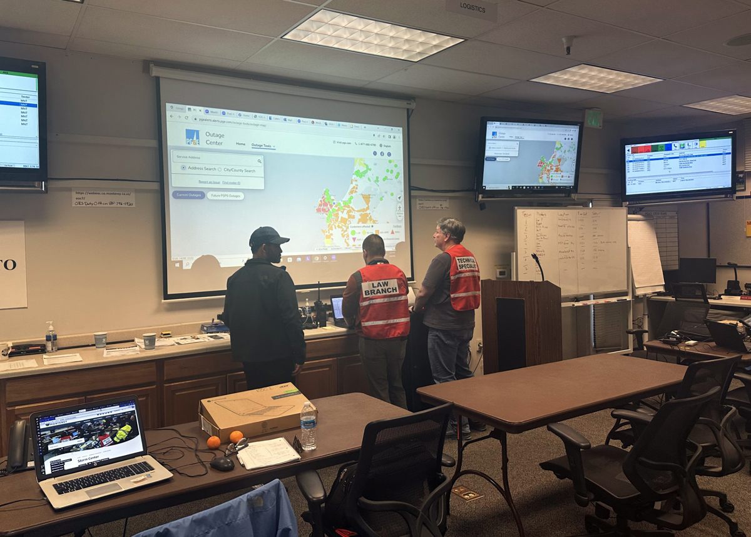
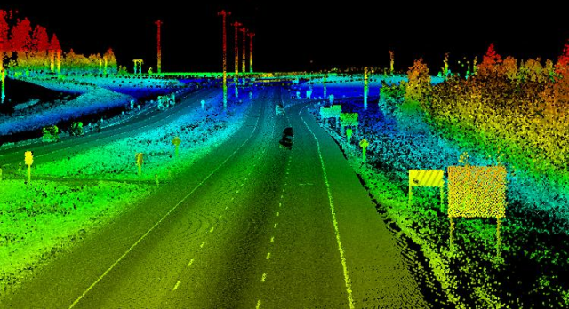
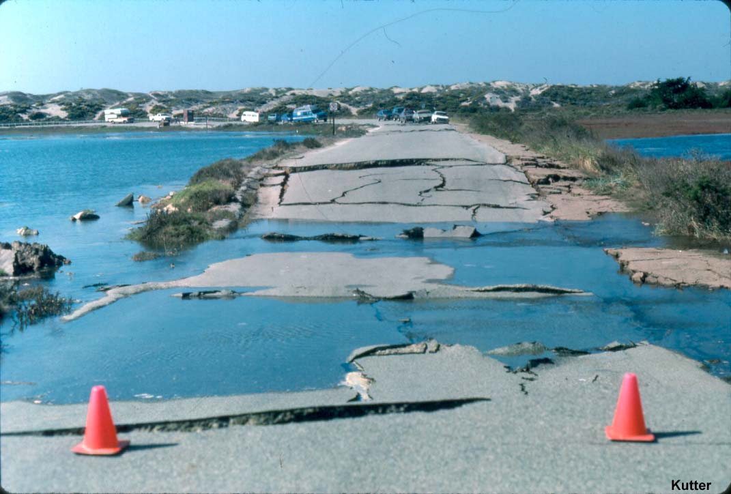
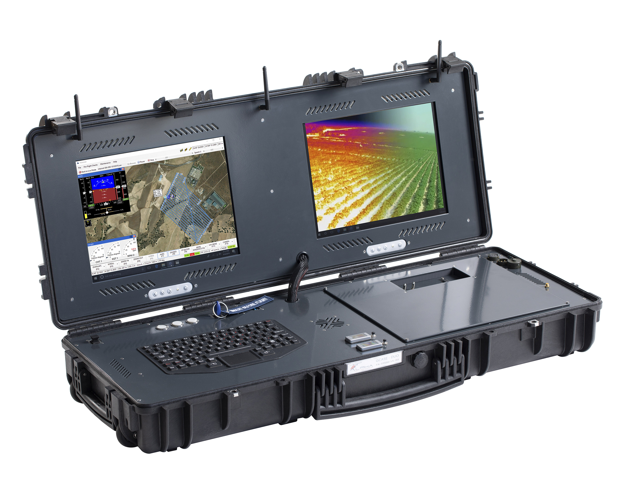
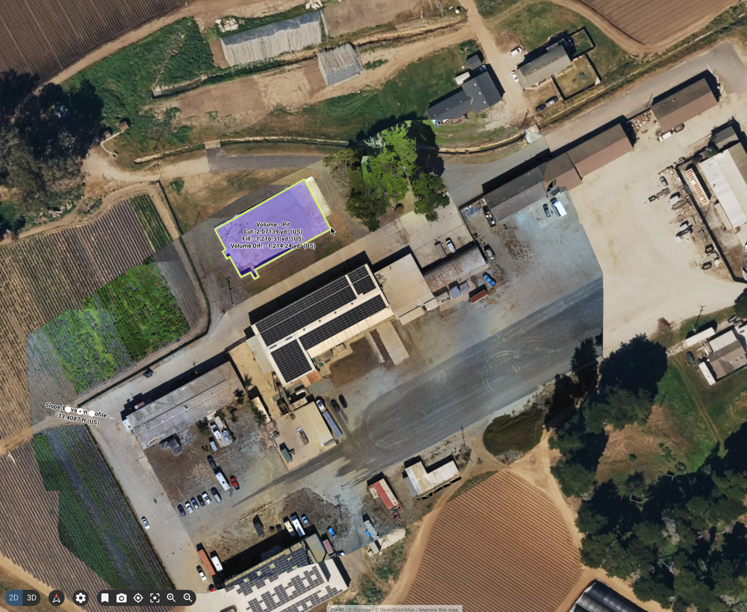
Project Concept
Monterey
County Database
Long Range UAS Data Collection (LiDAR, Imagery, Live Video)
Team Awareness Kit (video, maps, position/status)
Flight Information Exchange
Monterey EOC
Ground Control
UAS Ops
1st Responders

Slide 8
Project Schedule
 | 2025 |  |  |  | 2026
 | Q1 | Q2 | Q3 | Q4 | Q1 | Q2
Phase 1: Planning & Regulatory
Phase 2: Testing & Evaluation
Phase 3: Final Analysis
2-week Field Tests

Slide 9
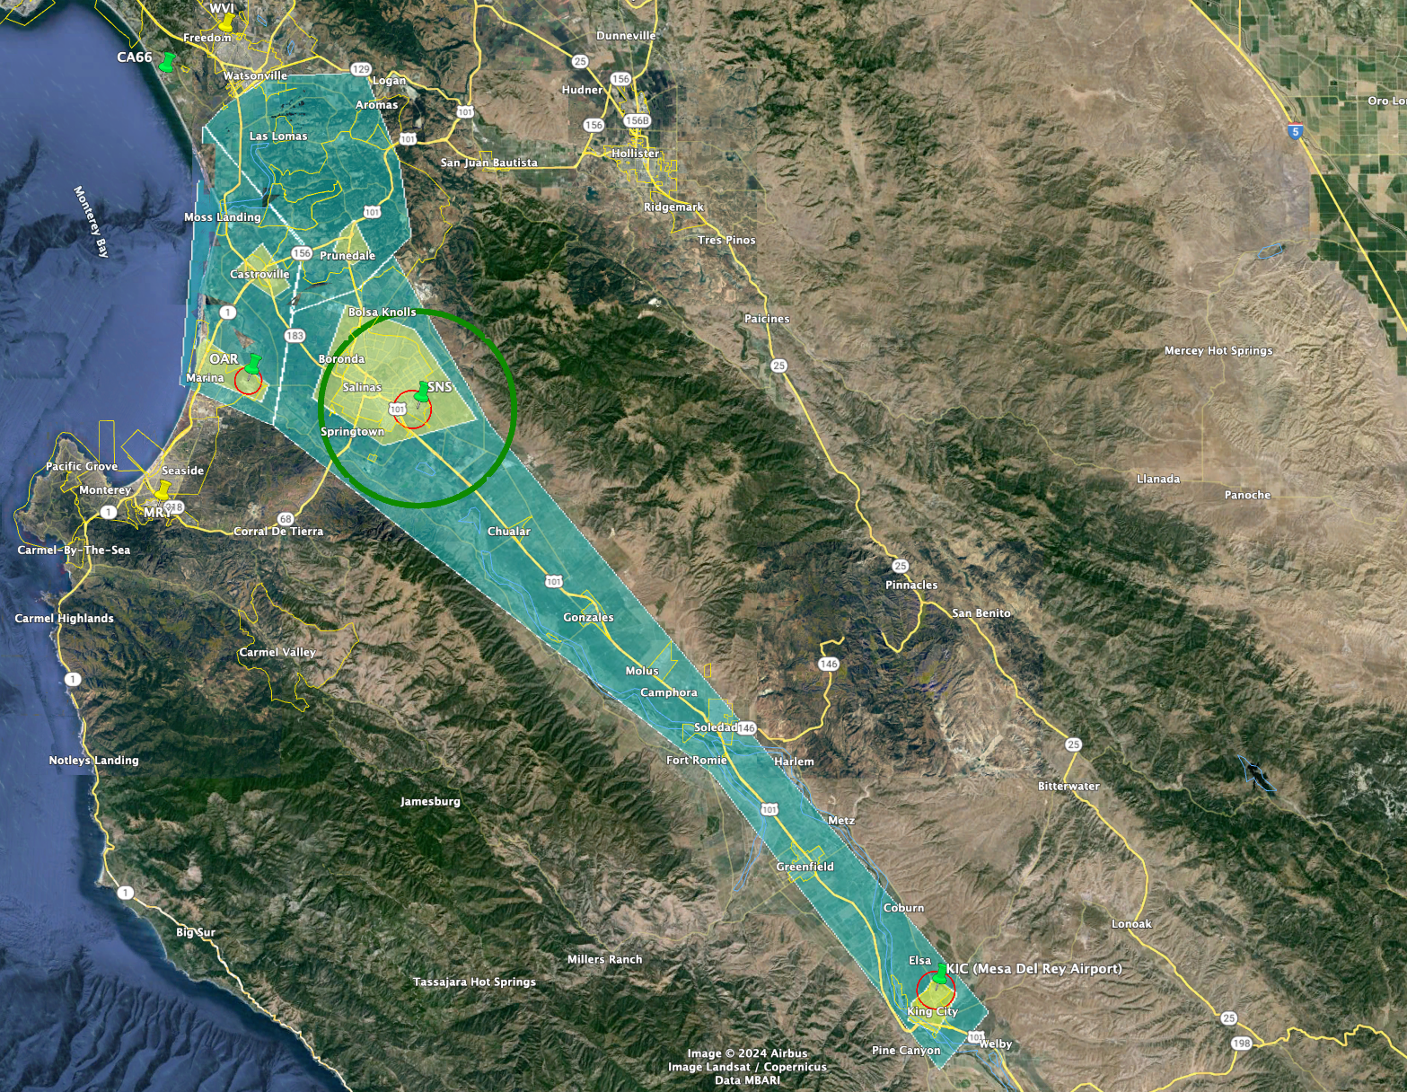
Project Area Map

Slide 10
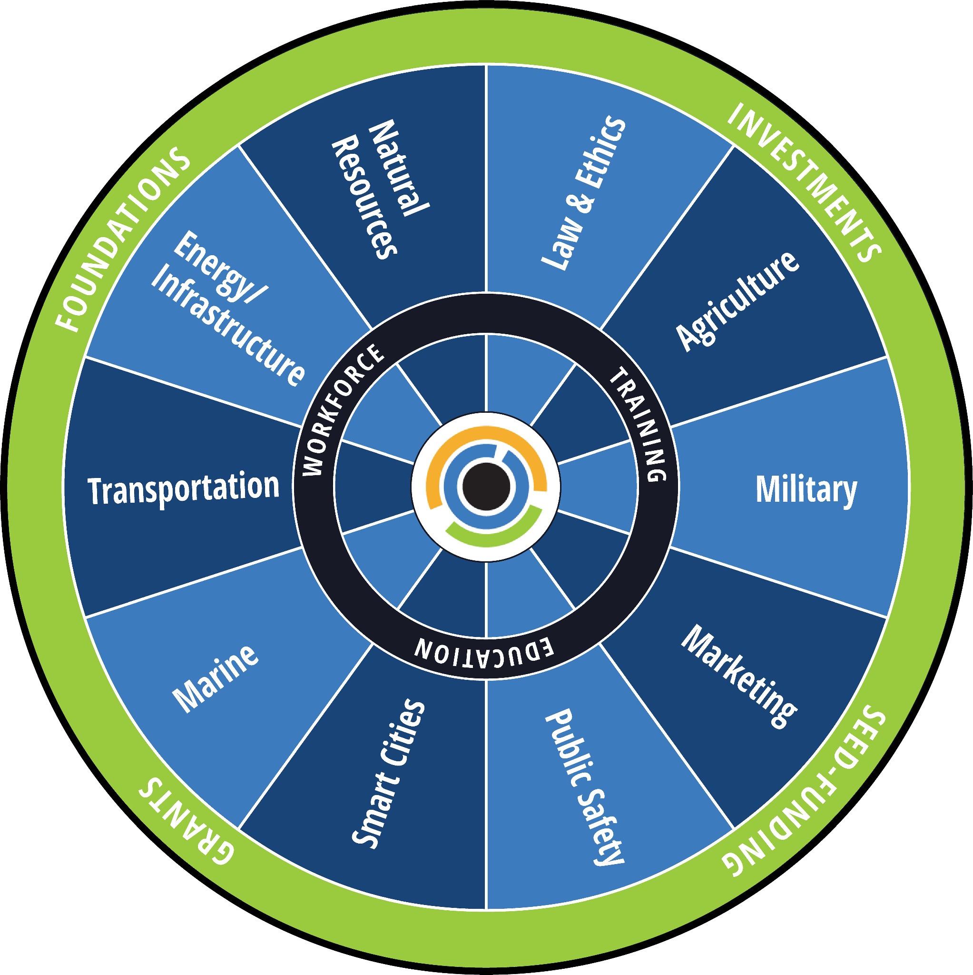
&
Thank You!
Josh Metz
josh@montereybaydart.org
MBDART.org

Slide 11
Budget Summary
Type | Participant / Category | Project Funding Required
Type | Participant / Category | Project Funding Required
Direct | Transportation Agency for Monterey County | $236,424
Contractor | Monterey Bay DART | $297,756
Subcontractor | Monterey Department of Emergency Management | $100,100
 | University of California Santa Cruz | $37,680
 | University of Alaska Fairbanks | $89,929
 | ATA Aviation | $301,144
 | Airspace Integration | $248,342
 | Aloft | $60,400
 | OneSky | $96,180
Supplies | Supplies | $29,750
Equipment | Sensor Equipment Purchased | $298,000
Contractual | Sensor Equipment Leased | $283,450
Total | Project Total Funding Required | $2,079,154
Total | Partner Committed Match | $153,700
Total | Federal Funding Request | $1,925,454

Slide 12
Requested Motion
Authorize TAMC Executive Director to submit the CC-TASCR SMART Grant Proposal and, if awarded complete necessary contracting for Project Implementation

Slide 13
&
Vision
Industry
Government
Companies
Products
Services
Capital
Entrepreneurs
Policy
Infrastructure
Regulation
Funding
Academia
Community
Education
R&D
Innovation
Talent
Workforce
Integration
Services
Advocacy
Notes:
Bring together and foster coordination between Industry, Government, Academia & Practitioners in Drone, Automation/Autonomy, and Robotics Technology to pursue opportunities for regional advancement, innovation, and economic development.Advancing safe & secure technology integration
Supporting private sector innovation & growth
Align industry, academia, government, and workforce towards emerging opportunities, for new venture formation, jobs growth and community economic vitality.

Slide 14
SMART Project Design
Focus: Disaster Preparedness & Resiliency - Transportation Infrastructure Damage Assessment & Aerial Cargo Logistics
Consortia Finalized - Government, Industry, Academia, Community
Key Gov Collaborators: MB DEM, CalOES, CalTrans, FAA, NASA
Industry: Airspace Integration
Academia: UC CITRIS
Community Engagement: MB DART & MB Tech Hub partners
Committed Roles, Responsibilities, Worklanes
Finalizing Planning and Prototyping Grants Stage 1 Budget
Refining Project Proposal Write Up
Notes:
DART has been the driving force behind identifying potential funding sources to seed the initial infrastructure development to enable services.
DART has been engaged in Consortia Building and Project Design over the past year, plus

Slide 15
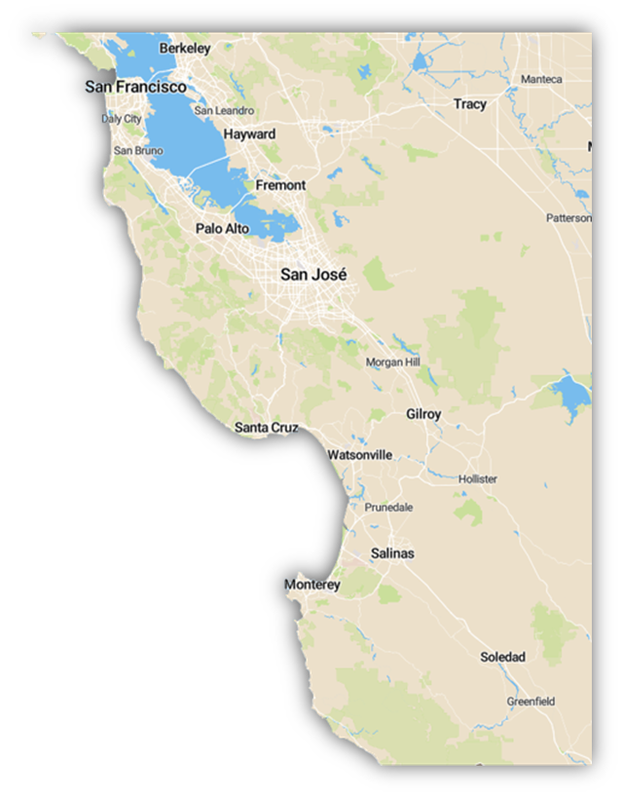
Monterey Bay DART
Convergence of intentionality, geographic and
cultural assets, timing and luck
2024
Notes:
Responding to call from Federal government to reshore manufacturing under the Chips act

Slide 16
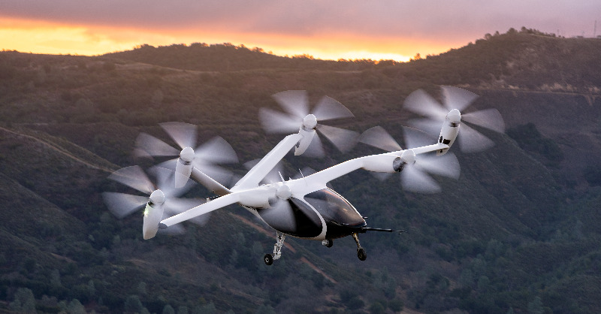
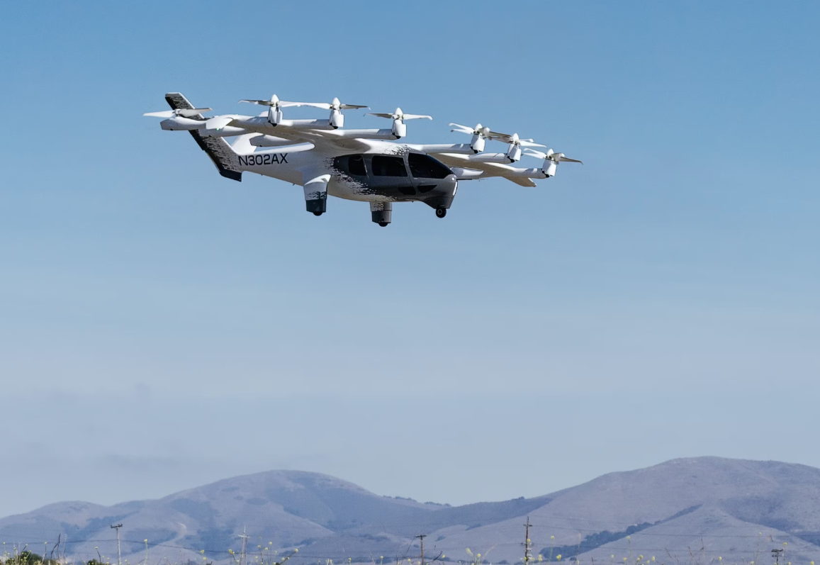
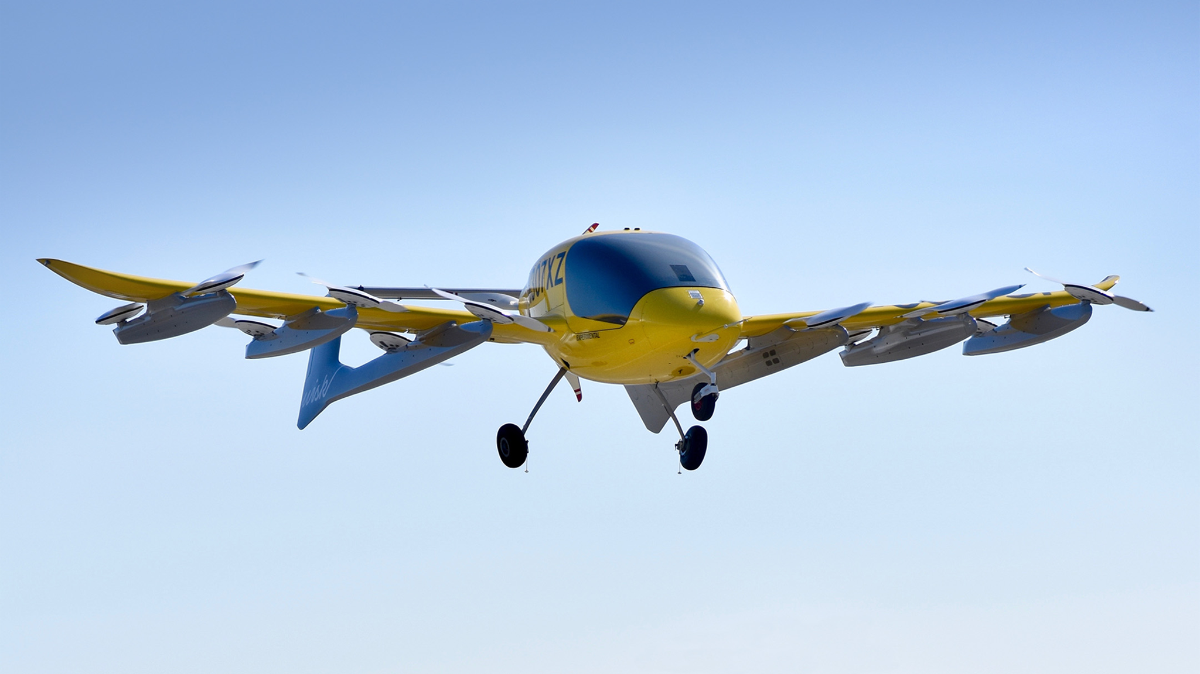
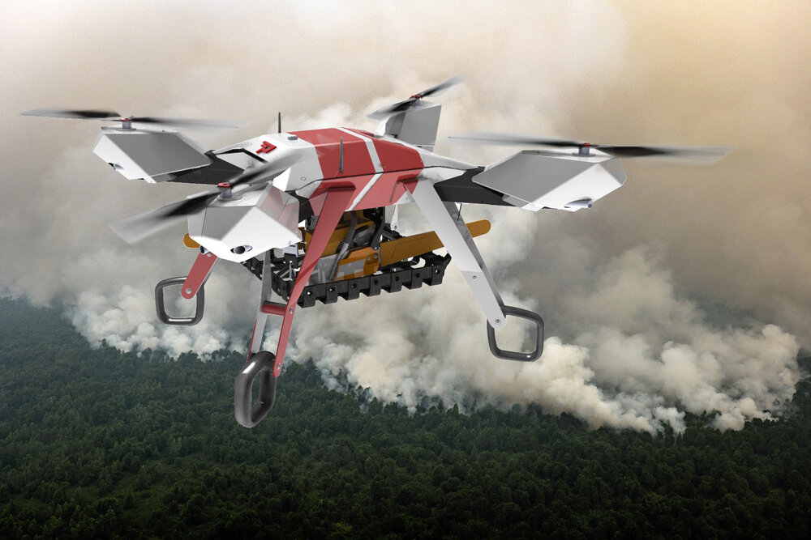
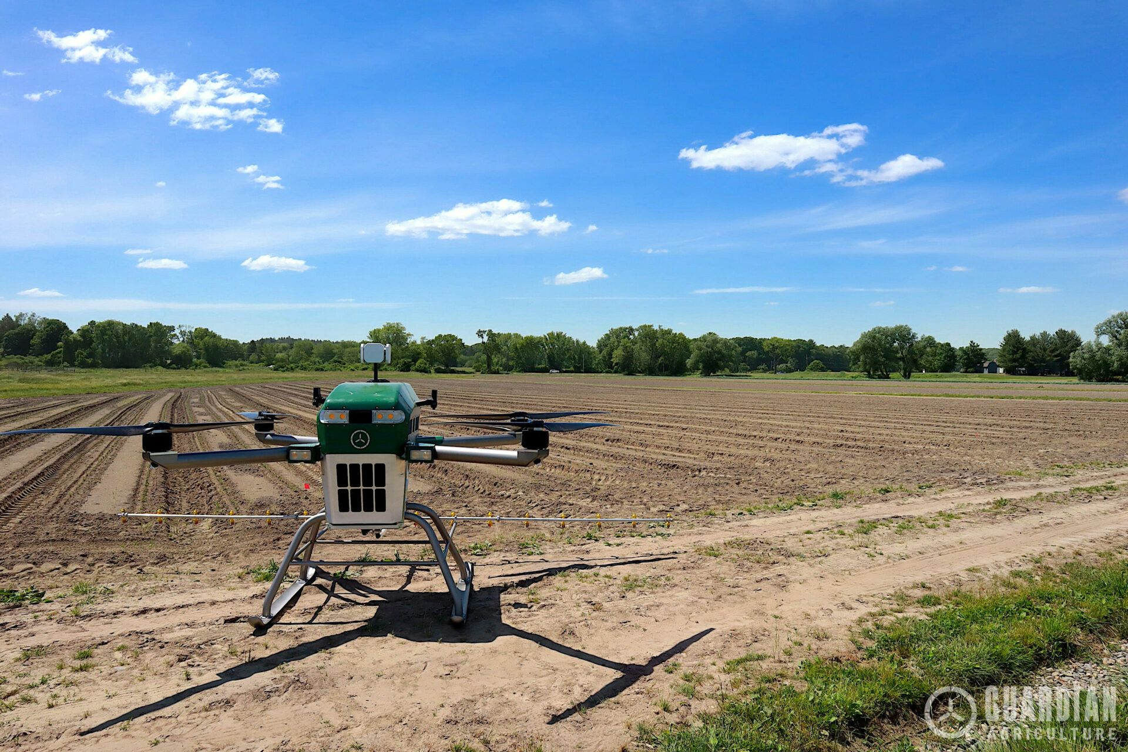
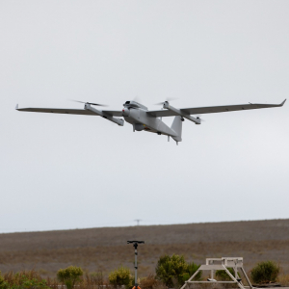
Notes:
Add Parallel Flight, Guardian Ag Drone, and Aerovironment Jump20

Slide 17
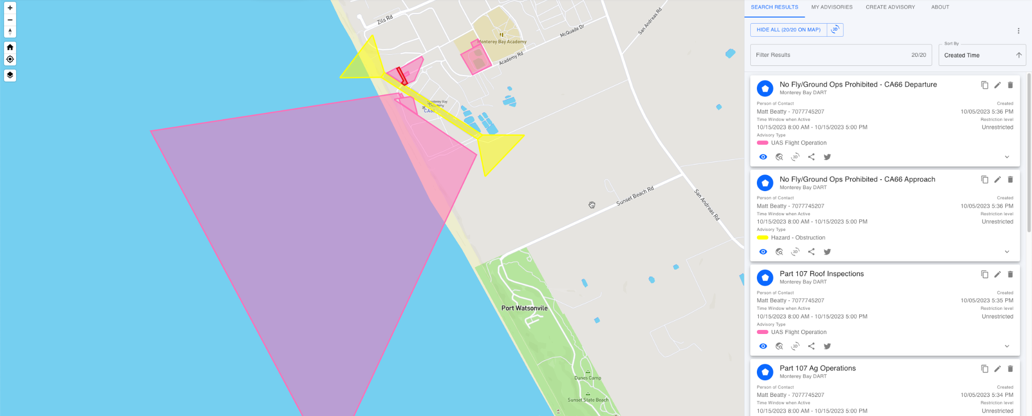
cc-fix.com
Notes:
We see multiple opportunities to grow our NPS partnership.
Becoming familiar with existing people, programs & initiatives
Increasing access to JIFX quarterly activities
Supporting SLAMR
Training, industry partnerships CHS
The Sea Land Air Military Research Facility (SLAMR) will be our nation’s only facility that allows researchers to experiment with robotics in multi-domain environments, specifically, sea, land, air, space and cyberspace.
But SLAMR won’t exclusively focus on military operations. “We need to help our entire country raise the game in cybersecurity,” says Ray. That's why SLAMR will connect private industries, academic institutions and government entities to collectively tackle cybersecurity issues. And with 5G networks, the connection will be quite literal. Other universities, industry labs and military ships will be able to be part of the work happening at SLAMR, regardless of their location. https://www.npsfoundation.org/posts/slamr-facility

Slide 18
DOT Strengthening Mobility and Revolutionizing Transportation (SMART)
Key Information
Notice of Funding Opportunity NOFO released 5/13/24
2 Stage Opportunity
Planning and Prototyping Grants Stage 1 - Max $2MM, 18 month Period of Performance
Implementation Stage 2 - Compete Max $15MM, 36 month Period of Performance
No Cost Share or Matching Requirement Stage 1
Avg Award Stage 1 = $1.5MM;
Eligibility: State, Political subdivision of a State, Tribal government, Public Transit Agency or Authority, Public Toll Authority, Metropolitan Planning Organization, A group comprised of the above 2 or more eligible entities
Phase 1 Submission Deadline: July 12, 2024
Notes:
The Transportation Agency for Monterey County (TAMC) serves as Monterey County’s regional transportation planning agency, and is a state designated agency responsible for planning and financial programming of transportation projects.
“15. Is my organization considered a political subdivision of a state?
Under the SMART Grants Program, entities may be a political subdivision of a State if they are a unit of government created under the authority of State law. This may include cities, towns, counties, associations of government (AOGs), councils of government (COGs), and regional councils.

Slide 19
Budget Summary
Participant / Category | Type | Project Funding Required
Transportation Agency of Monterey County | Direct | $236,424
Monterey Bay DART | Contractor | $297,756
UC/CITRIS | Subcontractor | $37,680
ACUASI | Subcontractor | $89,929
Monterey Department of Emergency Management | Contractor | $100,100
ATA | Subcontractor | $301,144
Airspace Integration | Subcontractor | $248,342
Aloft | Subcontractor | $60,400
OneSky | Subcontractor | $96,180
Supplies | Supplies | $29,750
Sensor Equipment Purchased | Equipment | $298,000
Sensor Equipment Leased | Contractual | $283,450
Project Total Funding Required | Total | $2,079,154
Partner Committed Match (DART, ASI, ATAA) | Total | $153,700
Federal Funding Request | Total | $1,925,454

Slide 20
Budget Summary
Type | Participant / Category | Project Funding Required
Direct | Transportation Agency of Monterey County | $236,424
Contractor | Monterey Bay DART | $297,756
Subcontractor | Monterey Department of Emergency Management | $100,100
 | UC/CITRIS | $37,680
 | ACUASI | $89,929
 | ATA | $301,144
 | Airspace Integration | $248,342
 | Aloft | $60,400
 | OneSky | $96,180
Supplies | Supplies | $29,750
Equipment | Sensor Equipment Purchased | $298,000
Contractual | Sensor Equipment Leased | $283,450
Total | Project Total Funding Required | $2,079,154
Total | Partner Committed Match (DART, ASI, ATAA) | $153,700
Total | Federal Funding Request | $1,925,454

Slide 21
CCAI Area Cost Estimates
Minimum Viable Infrastructure
Own/Lease | Sensors / Software | Units | Unit Cost | Supplies, Cabling, etc. | Power and Connectivity | Fixed Cost | Leased Cost
Lease Annually | RemoteID | 27 | $1,200.00 | $2,700.00 | $1,800.00 | $0.00 | $97,200.00
Lease Annually | Advanced Weather Sensor | 1 | $1,500.00 | $500.00 | $1,200.00 | $0.00 | $4,500.00
Owned | GNSS RTK | 6 | $2,500.00 | $300.00 | $2,400.00 | $15,000.00 | $0.00
Owned | ADS-B | 2 | $3,750.00 | $1,000.00 | $900.00 | $7,500.00 | $0.00
Lease Annually | Optical | 11 | $15,000.00 | $1,500.00 | $3,600.00 | $0.00 | $495,000.00
Owned | RF Triangulation | 9 | $10,000.00 | $1,000.00 | $2,400.00 | $90,000.00 | $0.00
Owned | Radar | 12 | $40,000.00 | $1,000.00 | $7,200.00 | $480,000.00 | $0.00
Lic Annually | AirDEX Flight Exchange | 1 | $100,000.00 | $0.00 | $0.00 | $0.00 | $300,000.00
 |  |  |  | $8,000.00 | $19,500.00 | $592,500.00 | $896,700.00
 |  |  |  |  | Cable/Connect | $24,000.00 | $58,500.00
 |  |  |  |  | Total | $616,500.00 | $955,200.00
 |  |  |  |  |  | All in HW/SW 3 Years | $1,571,700.00
Integration Labor Estimate: $520,000
Notes:
These are only estimates from previous enablement project design scenarios. It helps provide context of the ROM cost.

Slide 22
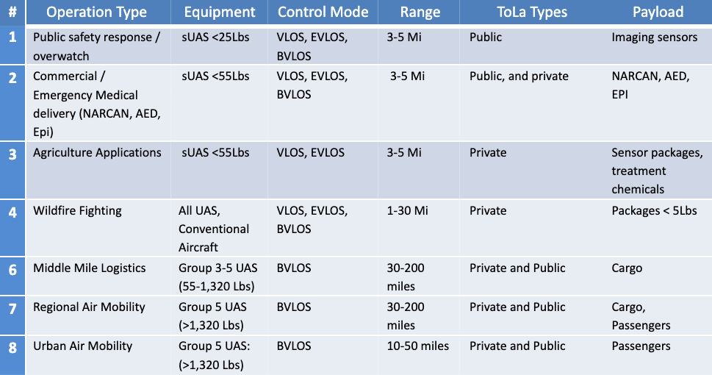
Use Cases Supported
Notes:
What would these use case operations look like?

Slide 23
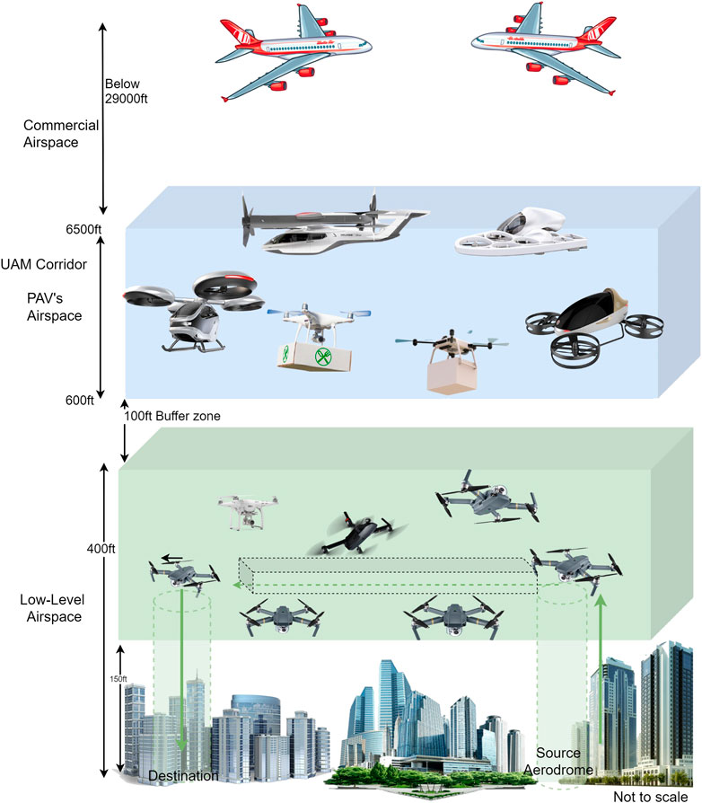
Advanced Air Mobility
Shared Airspace Users
Small-Medium Data + Special Purpose
Medium-large Cargo
Medium-Large Transportation
Projects underway across the country to increase safe and secure airspace uses
Notes:
Quick Primer/Clarification when we talk about AAM, UAS, Beyond Visual Line of Sight and what these technologies promise to deliver our communities
“AAM is a transportation system that moves people and property by air between two points in the United States (U.S.) using aircraft with advanced technologies, including electric aircraft, or electric vertical takeoff and landing (eVTOL) aircraft, in both controlled and uncontrolled airspace.”

