Slide 1
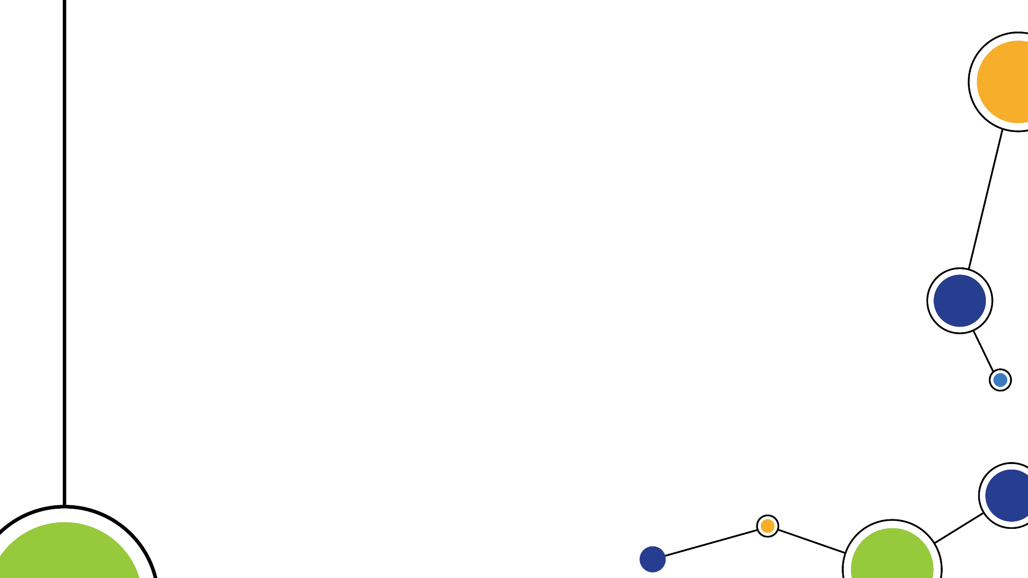
Monterey Bay Tech Hub
Infrastructure Working Group
March 7, 2024

Slide 2
Agenda
Proposed Working Group Mission
Potential Projects
AAM Readiness Assessment
CC-FIX
MB Tech Hub Infrastructure Strategy
Emergent
Other
Monterey Bay Tech Hub Update

Slide 3
Proposed Mission
Grow R&D supporting and AAM operation enabling infrastructure at Monterey Bay regional and local airports to:
Attract additional R&D activity
Pilot critical infrastructure and scalable approaches
Supporting and expand existing R&D activity
Strengthen relationships among AAM infrastructure stakeholder community from local to national scale
Deliver strategic AAM infrastructure development plan to larger Tech Hub group

Slide 4
Proposed Projects
AAM Readiness Assessment
Central Coast Flight Information Exchange
Tech Hub Infrastructure Strategy
Emergent Opportunities
Other?

Slide 5
AAM Readiness Assessment
6 regional/local airport focus
Monterey, Marina, Watsonville, Salinas, King City and Hollister
Potential Readiness Metrics
Facilities: fueling/charging, passenger, maintenance
Power Supply
Planning
Other
Funding Sources

Slide 6
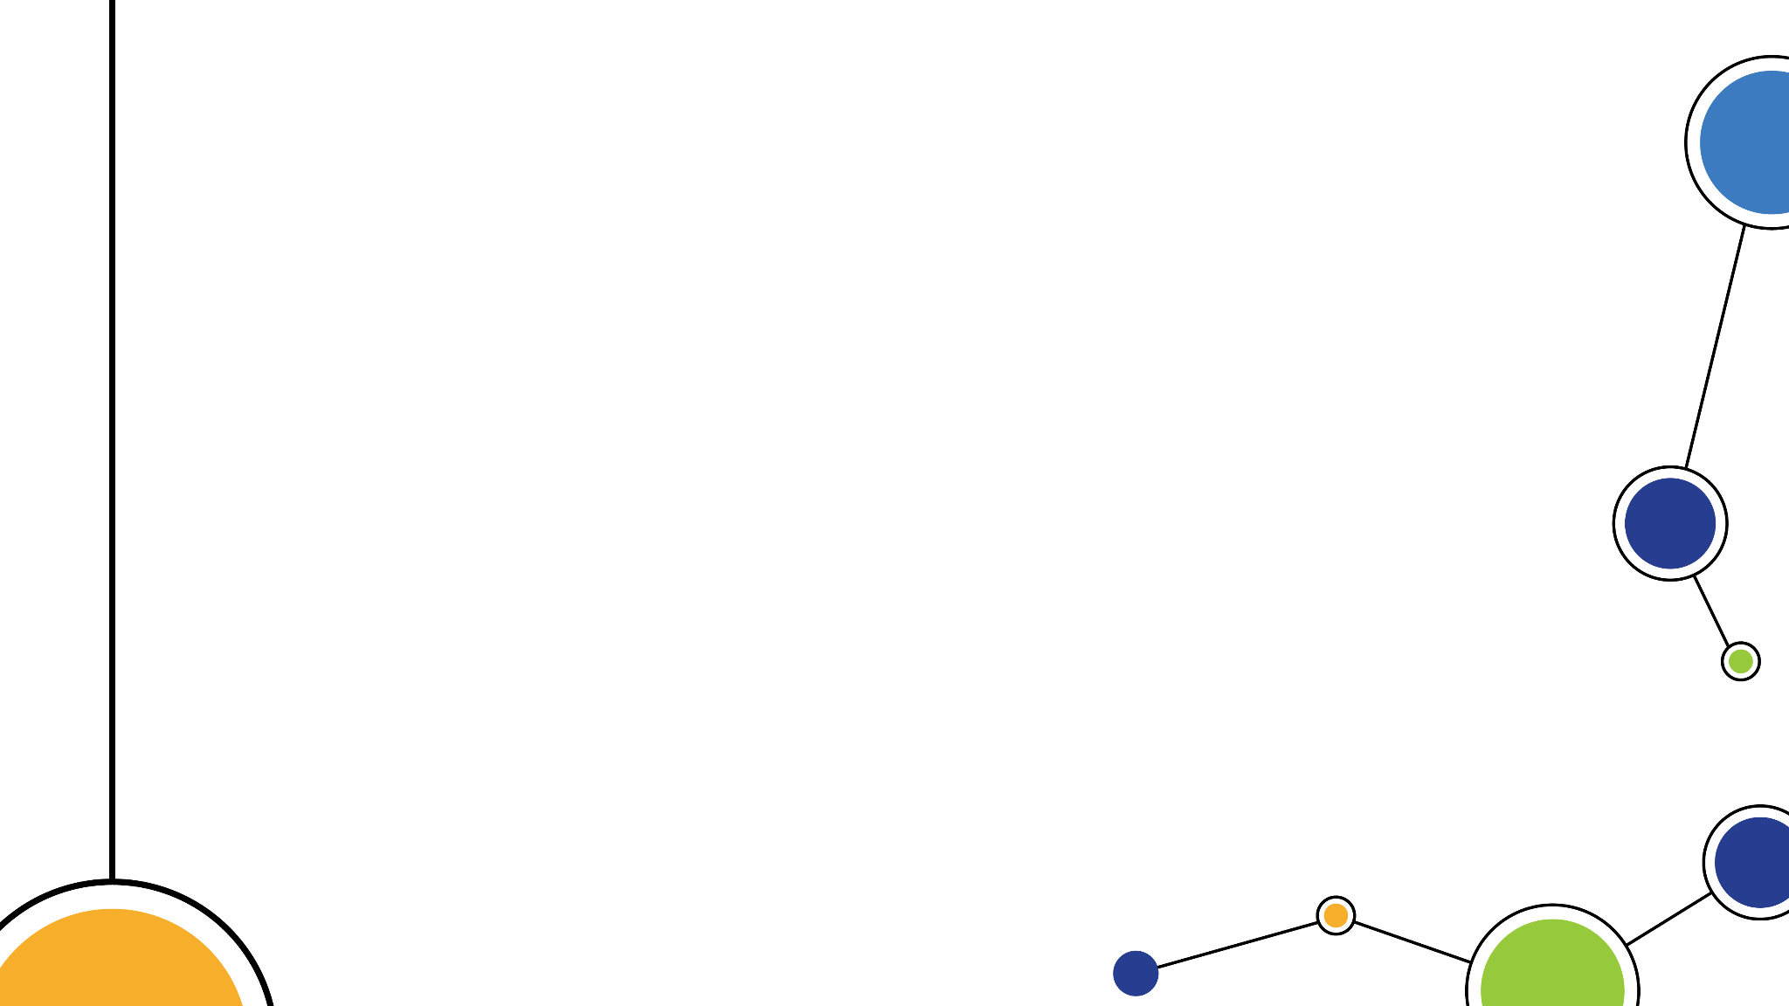
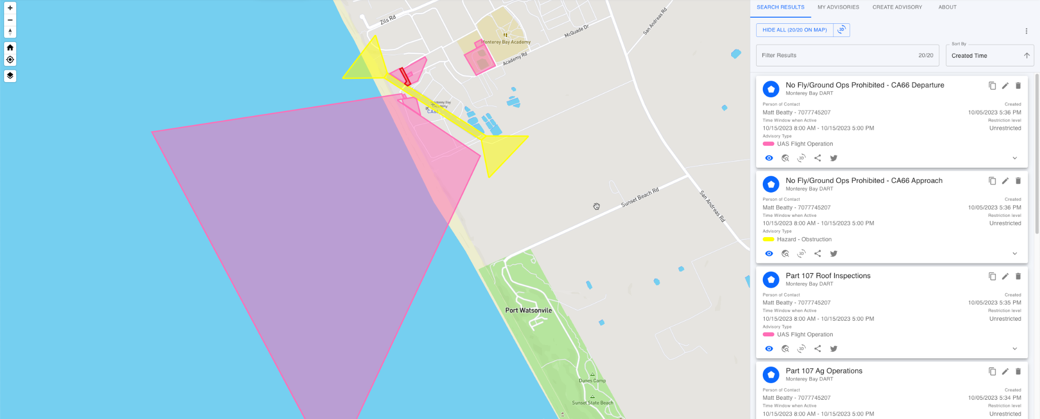
cc-fix.com
Notes:
We see multiple opportunities to grow our NPS partnership.
Becoming familiar with existing people, programs & initiatives
Increasing access to JIFX quarterly activities
Supporting SLAMR
Training, industry partnerships CHS
The Sea Land Air Military Research Facility (SLAMR) will be our nation’s only facility that allows researchers to experiment with robotics in multi-domain environments, specifically, sea, land, air, space and cyberspace.
But SLAMR won’t exclusively focus on military operations. “We need to help our entire country raise the game in cybersecurity,” says Ray. That's why SLAMR will connect private industries, academic institutions and government entities to collectively tackle cybersecurity issues. And with 5G networks, the connection will be quite literal. Other universities, industry labs and military ships will be able to be part of the work happening at SLAMR, regardless of their location. https://www.npsfoundation.org/posts/slamr-facility

Slide 7
Central California Airspace
Integration Cooperative (CCAIC) Area
Scoping Feasibility Study
Phase 1: Test Sites and Innovation Hubs Comparative Analysis
Phase 2: Funding and Revenue Model Analysis
Phase 3: Community Engagement & Evaluation
Phase 4: Refinement and Implementation Plan
Notes:
Phase 1: Test Sites and Innovation Hubs Comparative Analysis
(7) FAA Modernization and Reform Act Integration Sites
Other regional/State/Federal and Tribal funded AAM/UAS Innovation Hubs
Phase 2: Funding and Revenue Model Options
Phase 3: Community Engagement and Evaluation
Phase 4: Implementation

Slide 8
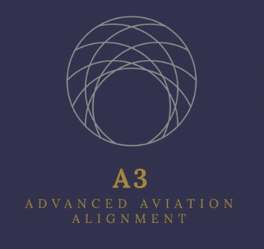
CCAIC Feasibility Analysis
FAA UAS Test Site Program
Griffiss International Airport, NY
New Mexico State University
ND Department of Commerce
State of Nevada
TX A&M University Corpus Christi
University of Alaska Fairbanks
Virginia Polytechnic Institute & State University
Analysis
Target Outcomes
Investments
Reasonable Return Expectations
Business Model/Sustainability
Potential Ecosystem Stakeholders
Inputs
Public Information
Selective Literature
Interviews
Success Criteria
Economic Impacts
Workforce Impacts
Ecosystem Innovation
Regional/State Sites
Tulsa Regional Advanced Mobility (TRAM) Corridor
FlyOhio
Private Sites
Tillamook Test Range, OR
Pendleton Test Range, OR
*Target Fall 2024 Completion

Slide 9
DOT SMART Target
Key Information
Sept 2024
NOFO not yet released
State or local governments, transit agencies, MPOs, or other political subdivisions of SLTT, multijurisdictional group or consortia
FY 22 Project Stats:
59 of 392 funded
$94M total
$1.5M avg
Strengthening Mobility and Revolutionizing Transportation (SMART)
Notes:
Phase 1: Test Sites and Innovation Hubs Comparative Analysis
(7) FAA Modernization and Reform Act Integration Sites
Other regional/State/Federal and Tribal funded AAM/UAS Innovation Hubs
Phase 2: Funding and Revenue Model Options
Phase 3: Community Engagement and Evaluation
Phase 4: Implementation

Slide 10
MB Tech Hub Infrastructure Strategy
Strategic Infrastructure Plan
Definitions
Key Projects
Funding Targets
Etc.
Needs Funding
Notes:
Phase 1: Test Sites and Innovation Hubs Comparative Analysis
(7) FAA Modernization and Reform Act Integration Sites
Other regional/State/Federal and Tribal funded AAM/UAS Innovation Hubs
Phase 2: Funding and Revenue Model Options
Phase 3: Community Engagement and Evaluation
Phase 4: Implementation

Slide 11
Emergent Opportunities
Go-Biz Project Blue
Archer Vertiport
Others?
Notes:
Phase 1: Test Sites and Innovation Hubs Comparative Analysis
(7) FAA Modernization and Reform Act Integration Sites
Other regional/State/Federal and Tribal funded AAM/UAS Innovation Hubs
Phase 2: Funding and Revenue Model Options
Phase 3: Community Engagement and Evaluation
Phase 4: Implementation

Slide 12
Monterey Bay Tech Hub Update
Governance model forthcoming
Include nomination process
Zeroing in on MBTechHub.org
Notes:
Phase 1: Test Sites and Innovation Hubs Comparative Analysis
(7) FAA Modernization and Reform Act Integration Sites
Other regional/State/Federal and Tribal funded AAM/UAS Innovation Hubs
Phase 2: Funding and Revenue Model Options
Phase 3: Community Engagement and Evaluation
Phase 4: Implementation

Slide 13
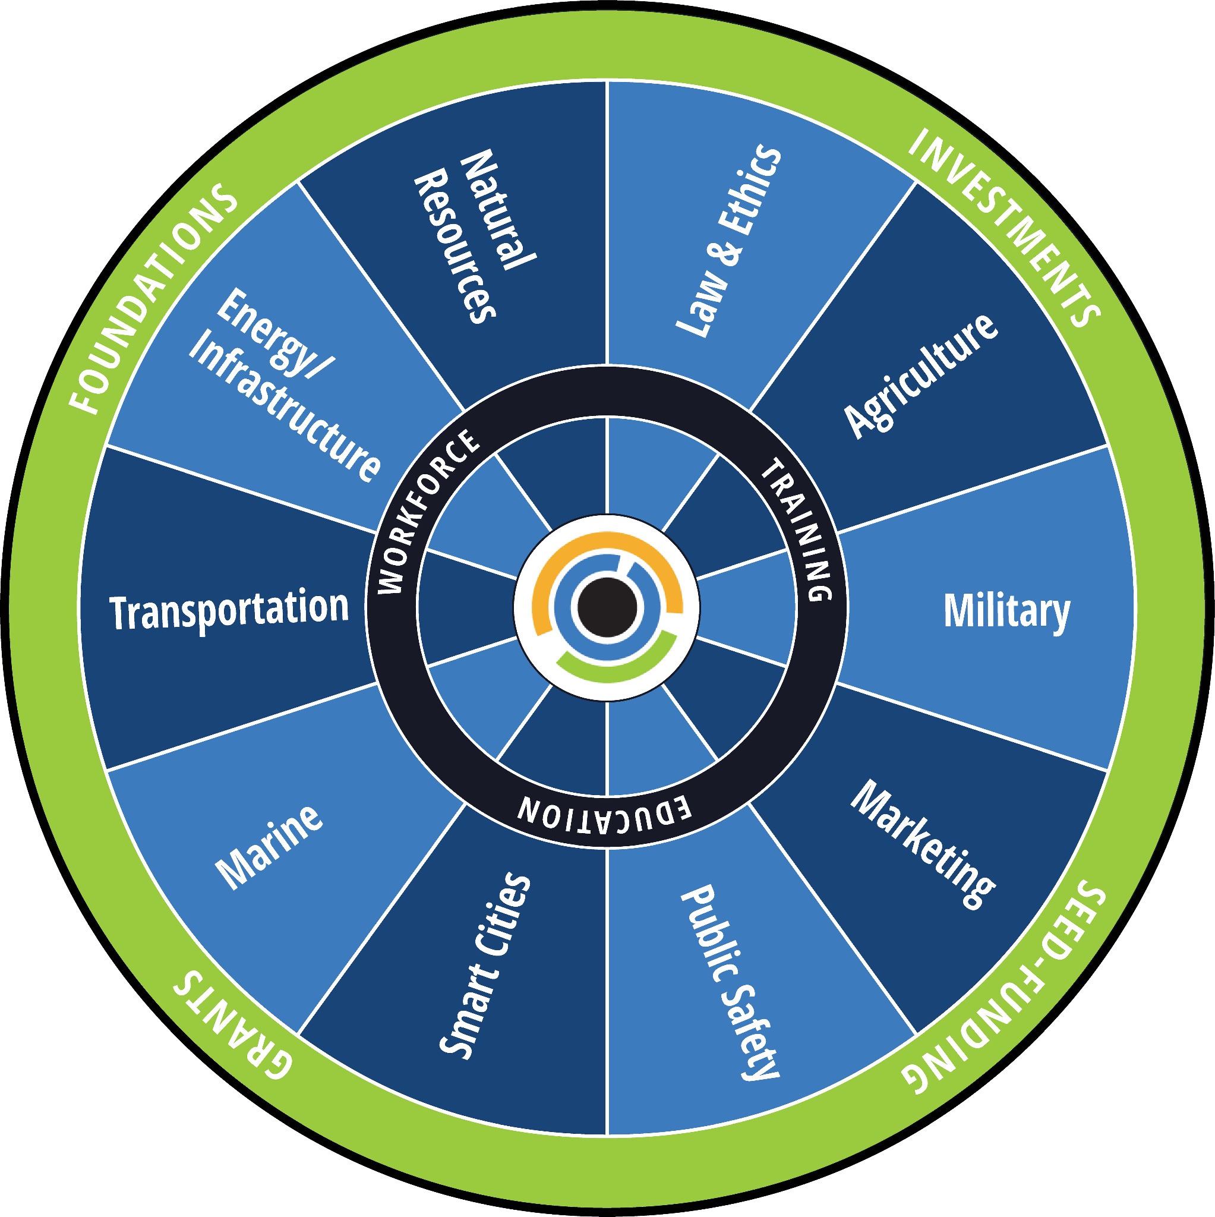
&
Thank You!
Josh Metz
josh@montereybaydart.org
MBDART.org

